Slide 1

Text Summarization : A Study of BERT and Classical NLP Approaches
Sharon Zacharia
22074407

Slide 2

Project Introduction
Natural Language Processing (NLP) – Enabling Human like language interaction with computers.
This study compares transformer-based model BERT, with classical NLP methods for Text summarization.
Traditional techniques like bag-of-words and TF-IDF are effective on smaller datasets due simplicity & lower computational needs.

Slide 3

Research Questions
Do Transformer based models outperform Classical NLP techniques in text summarization?
How do transformer-based models compare to NLP approaches in terms of accuracy and computational efficiency?

Slide 4

Bag of words
Preprocessing
Preprocessing : Input text is cleaned and tokenized
Generate
Vocabulary Creation : Generate a list of unique words and map them to indices.
Represent
Vectorization: Represent each document as a vector of word counts based on the vocabulary.
TF-IDF
TF
Term Frequency : Count how often a term appears in a document.
IDF
Inverse Document Frequency : Compute the rarity of a term across all documents.
TF-IDF Score:
Multiply TF by IDF to weight terms, emphasizing unique words..

Slide 5

BERT - Bidirectional Encoder Representations from Transformers
Contextual Understanding: BERT uses bidirectional context, meaning it looks at both the left and right sides of a word to understand its meaning.
Pre-trained: Pre-trained on large corpora & fine-tuned for specific NLP tasks like text summarization.
Transformer-Based: Built on the Transformer architecture, allowing parallel processing of input and understanding complex dependencies.
Performance: Achieves leading results in many NLP tasks, including summarization, question answering, and text classification.
Abstractive Summarization: Can generate human-like summaries by rephrasing and synthesizing content, unlike traditional extractive methods.

Slide 6
Rouge Score
Measures the overlap between generated and reference summaries.
ROUGE-1: unigram (single word) overlap.
ROUGE-2: bigram (two consecutive words) overlap.
ROUGE-L: Evaluates the longest common subsequence, capturing sentence structure.

Slide 7
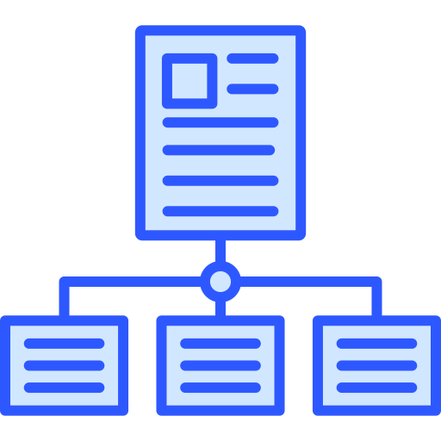
CNN / Daily mail Data Set
Dataset containing news articles for training and evaluating text summarization models.
Comprises over 300,000 articles with human-written summaries
Each article is divided into sentences, with summaries capturing the main points
Field | Description
Id | Unique id for each article
Article | Body of news
Highlights | Highlight of article

Slide 8
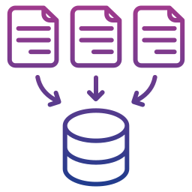
Data Storage & Sharing
Document Control:
GitHub Repo: Link to Repository
Version Control : Code and version changes are tracked through Git
File Naming : a consistent file naming convention which ensures clarity and easy identification will be used throughout the project
Security and Storage:
Backup: Data and code will be backed up regularly on GitHub, Google drive and one drive.
Data Sharing: Shared through GitHub Repository , Google collab and Cloud storage links.

Slide 9

Data Privacy and Ethics
GDPR Compliance: Data is anonymized and publicly available
UH Ethical policies: Data set adheres to the UH ethical policies and guidelines
Permission to use: Publicly available dataset which is widely used in academic research
Data Collection: data is ethically collected by the researchers at google DeepMind and university of oxford for research purpose

Slide 10
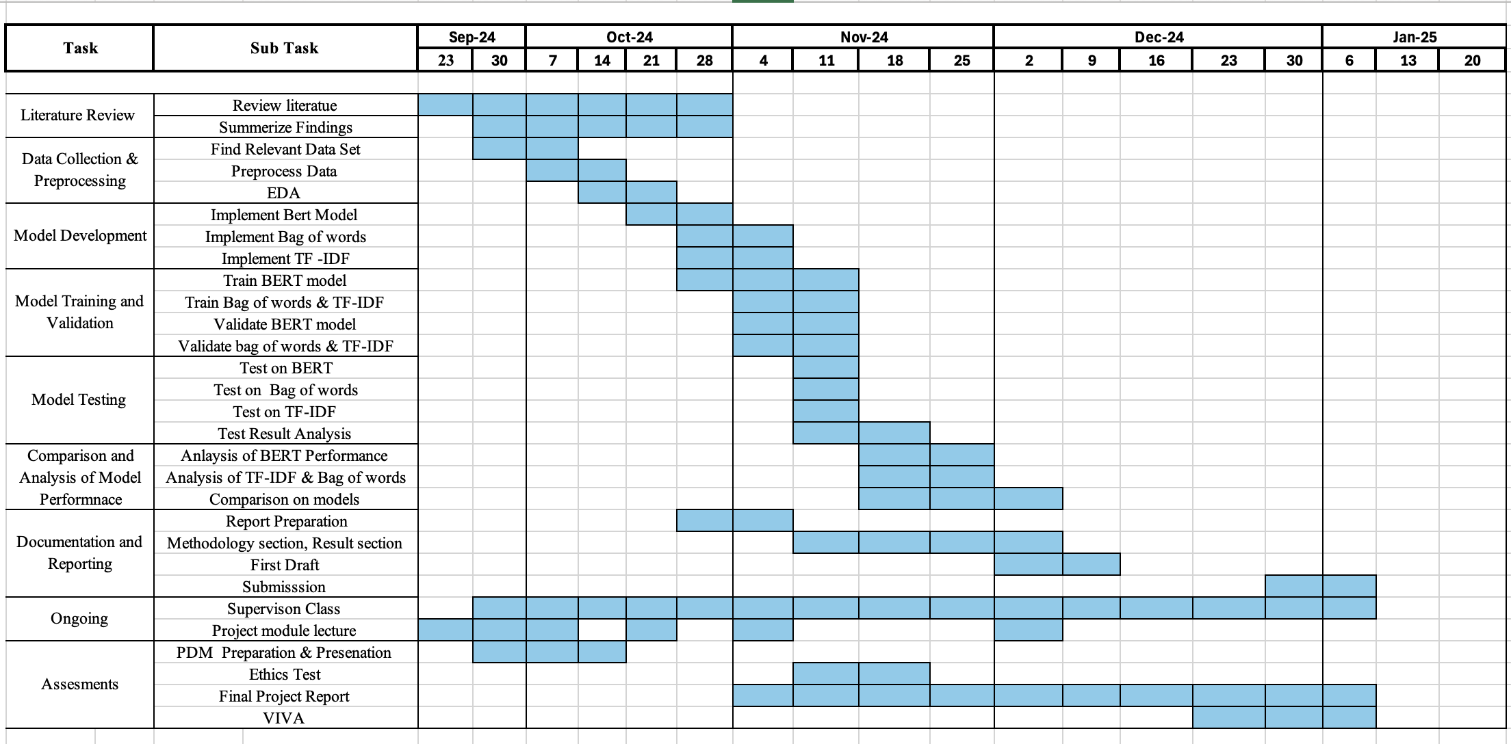
TimeLine

